Slide 1

Applications and systems integration
Nadya Williams (UCSD) nadya@sdsc.edu

Slide 2
What we are trying to
Increase availability and flexibility of Software as a complete system
reduce cost of installing/configuring/replicating
ease burden of integrating hardware and software
Enable a fast “workflow” from software update to server availability:
Minimize time spent on software build and configuration
Automate most hands-on tasks.
Essential: have test cases for all installed components and their configuration
Virtualization
Applications
Create a complete system as an end-to-end solution
Infrastructure
Practical use of PRAGMA cloud infrastructure
Encapsulate the complexity of software build and configuration
Reduce cost of installing, configuring, replicating
SaaS
PaaS
Notes:
Software as a Service (SaaS) : use of software that is hosted on a centralized network service.
PaaS : provides a comprehensive platform that developers can use to develop, test, deploy, and maintain applications.
This is a valuable teaching and development tool, provides access to creation and management of sophisticated applications

Slide 3
Challenges
Server provisioning
automate, optimize
Managing, scaling and automating cloud applications
Migrating from physical to virtual host
Application packaging and distribution
Virtual resource control: allocate memory, disk
Environment is different during build and run time
Unify physical and virtual
Can we merge applications management for physical and virtual hosts?
Can we build in reproducible way?
How do we ensure that adequate virtual application performance is maintained ?
How to tune performance
How to troubleshoot problems
Development
Software update or release
Rebuild the roll
Install test server
Run test server
Bug fixes/upgrades
Production
2
Build production server
1

Slide 4
Anything done more than once need to be automated !
Identify what to automate and when
Which tools to use and how
Time
Can not make any assumptions about the system
Automating operational, time consuming and repetitive tasks
Application “minimal resources” requirements
Monitoring and troubleshooting
Automate service delivery - provide seamless integration of hw/sw
Provisioning in reproducible way - enables to clone multiple servers
Cut build time from days to hours
Know your system real-time status: what is installed, what version, configuration
Robust system: can reliably build and rebuild
Software build, configuration, customization
Robust system: can reliably build and rebuild
Enable operational efficiency and flexibility: deployment and operation of servers
An absolute prerequisite for migration to the cloud
Time
Time
Notes:
Automation is no longer nice to have it is a must have that allows to:
Know your system real-time status: what is installed, what version, configuration, data population
Robust system: can reliably build and rebuild
Address complexity of configuring – no more manual settings
What issues need to be documented?
Facilitate easy-to-use solution to provide seamless integration of hw/sw
Allow to virtualize infrastructure to improve hw utilization and scalability
Enable operational efficiency and flexibility: deployment and operation of virtual servers
Enables to clone multiple servers
Manual hands-on tasks:
Software packages build
Custom scripts
User work-around
Repetitive tedious functions
Tracking errors, exceptions and problems
Legacy applications inherently tend to rely on in-home knowledge and previous installs, it is easy to slip into making assumptions (user setup, directory ownerships, etc).
Need to transform existing application management into dynamic, automated, simpler to provision and control.
Automating manual installation and configuration processes, reduces the potential for human error and eliminates legacy processes that can slow down VM provisioning.
The legacy systems are inflexible and unsuited to the dynamic nature of cloud computing because they are:
Complex, often bound to a very specific infrastructure, may be non-standard, fragile (depend on custom scripts)
Assumptions: can not make any about what is installed on the system, what defaults are, how system software is installed and configured.
Software installation must be a “build” process and not symlinks to directories checked out from the repository. The build process needs to ensure a reliable installation from scratch and from a know sw distribution version. This way the install process is reproducible. All install locations needs to be configurable, no hard coded paths.
Moving application from physical to virtual host has its own challenges.
Fact 1: Environment is different during build and run time
Fact 2: RPMS brought from outside repos (base, rpmforge, epel) may require an update to the RPMs present on the system. This may not be desirable. Solution:
check if update to RPM is working or breaking the system (openssl – support for secure communication)
may need to create a new RPM with an alternate location (libevent - abstract asynchronous event notification library)
Minimal resources requirements – need to define memory, disk space, queue allocation, etc.
In order to move to virtualization need to address the areas:
packaging (end-to-end as a roll),
distribution (provide upgrade, virtual install)
resource control (allocation of memory, disk to servers and clusters)

Slide 5
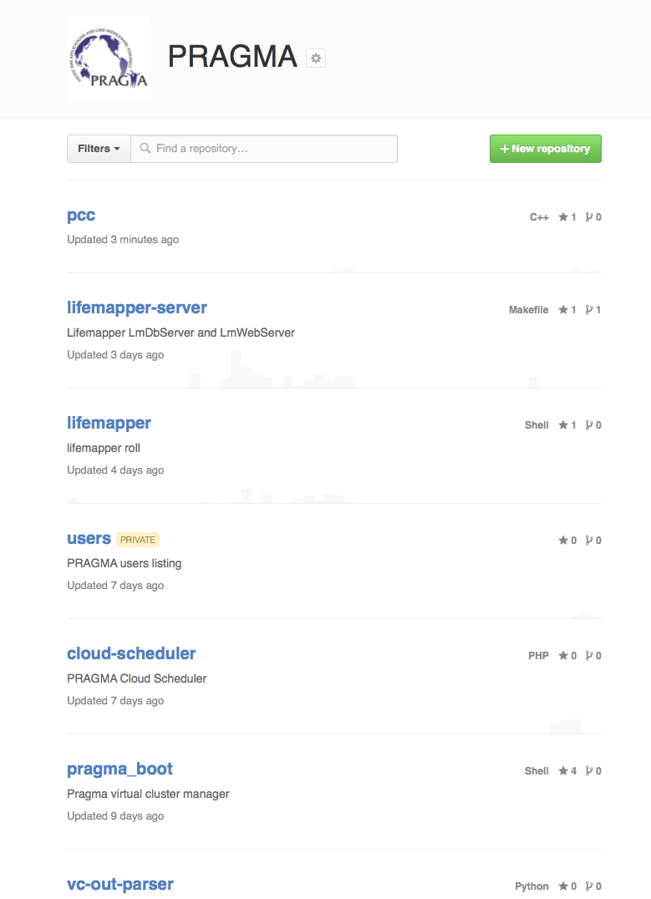
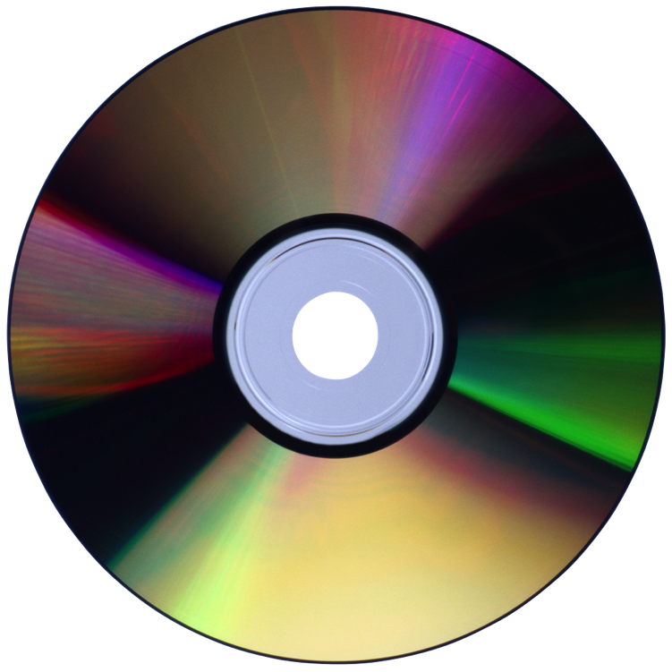
Cluster Overview
Cluster
kernel
os
Rolls
Create Frontend
hpc
base
ganglia
sge
web-server
Create compute nods
Hosting environment: KVM
. . .
frontend
compute node N
…
compute node 0
compute node 1
https://github.com/rocksclusters
https://github.com/pragmagrid

Slide 6
Roll Example: LifeMapper Server
Lifemapper
Postgresql
Postgis
Dependencies
LM code
Pgdg repo
Geos
Proj
Pgbouncer
LM data
Python modules
Mapserver
Elgis repo
Vera fonts
Server
Fribidi
Client
Devel
Contrib
Hdf44/hdf5
Subversion
Cmake
Byacc
Libraries
Openssl
Geos
Mod_python
SpatialIndex
Tiff
Cheetah
Cherrypy
Cython
Psycopg2
Pylucene
Rtree
Gdal
Species
climate
Pgbouncer
Configuration
Postgis
Postgresql
LM components
Total: ~68 RPMS
Notes:
Lifemapper Server Roll – create an end-to-end build process to enable an independent instance of Lifemapper data management and web services components. No “manual” work after packages installation: cluster comes up configured
Completely integrated build/install/configure process – automates entire lifecycle of application management and enables:
fast deployment, updates, rollback
provide for VM provisioning: building a virtual host is no different than physical
simplification of packaging and reliable robust deployment
full integration with the underlying cluster

Slide 7
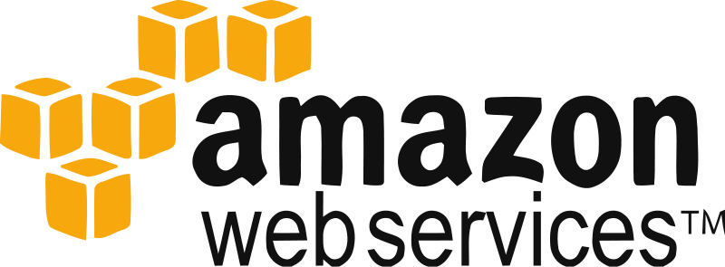
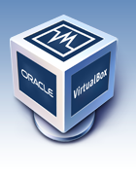
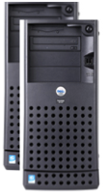
PaaS and the Cloudscape
Virtual Cluster Deployment
add sw
test
build cluster
reinstall
Advantages
Simplify development on a specific platform (ROCKS)
Minimize operational expense: from physical to virtual
Scalability: provide additional servers when needed
Portability: do once use many
Notes:
Data integration – generalize more to use heterogeneous datasets from different sources
Cloud approach – Extend and leverage with PCC and PRAGMA_Boot
Virtualized environment testing
Storage system
Performance estimates
What I/O volume can we handle without degraded performance?
Check for “storage I/O blender effect”
Need to define requirements for
performance
data storage
data management
Need to “translate” application/data requirements when application is moved from physical to virtual servers
Is there a bottleneck?
What is needed for IO-intensive application (database)?

Slide 8

Building Rocks Virtual Cluster
# rocks add cluster 67.58.51.168 1 fe-name=pc-168 \ # rocks start host vm pc-168
fe-container=pc-163 container-hosts=vm-container-0-9 \ # insert-ethers
vlan=1051 # rocks start host vm hosted-vm-0-0-0
# rocks start host vm pc-168
# virt-manager
Choose rolls
Cluster info
Root password
Start install
Installation
On virtual frontend
Frontend
Compute nodes
Notes:
Note: can specify vlan, fe-container, mem, disksize and disk location
# rocks set host vm pc-168 disk=file:/kvmdisks/kvm/disks/pc-168.vda,vda,virtio
Specify how to get the rolls : local CD, remote server, Select rolls
Specify cluster information: eth0, eth1, timezone, FQDN

Slide 9
Rocks Virtual Cluster: in VirtualBox on a laptop
Import VM
Start VM
Install roll
Run user application
5 min
3 min
15 min
Setup
Use
Steps:
Install VirtualBox, import VM, start VM
Install lifemapper-server roll
Use the image
Notes:
VirtualBox is a powerful x86 and AMD64/Intel64 virtualization product
Free and Open Source Software
runs on Windows, Linux, Macintosh, and Solaris hosts
Supports many guest operating systems
We’ve reduced the overhead of bringing up Lifemapper components so it can be done repeatedly to
Test robustness of code
Test alternate hardware
Test scalability
Test different input data
Demonstrate the process including application refactoring

Slide 10
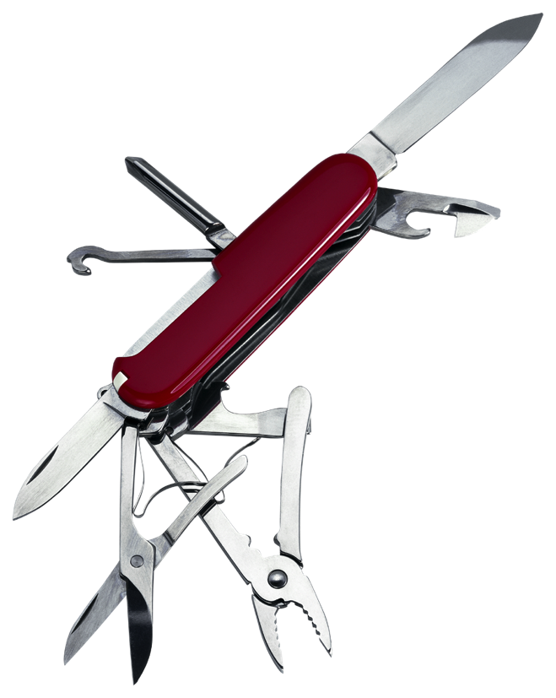
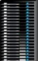
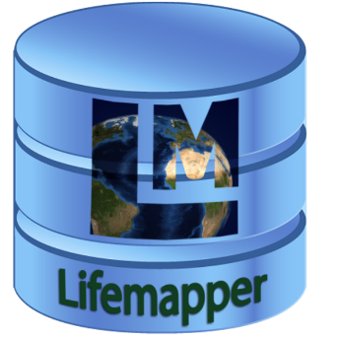
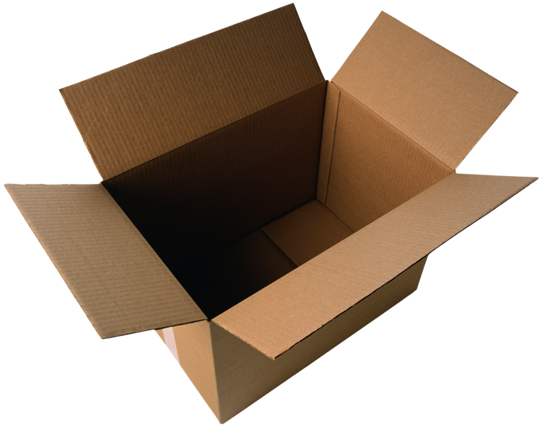
Actions
Automate Everything
Reuse
Integrate
Installs
Use software leverage
Data
vine2
configure
Open source software
pragma_boot
Script repetitive tasks
Choose portability
Ipop
packages
Small is good
Personal Cloud Controller
Notes:
Automate: save time, installs are consistent
SW leverage: good programmers write good code and great programmers borrow good code.
Don’t rewrite code that has already been written.
Find needed pieces and include in your code.
Portability of shell scripts over specific language code
A single program does a single thing well

Slide 11
Summary - Corollary
A product that fails to make a meaningful impact on users ends up failing.
There must be a visible reward.
Solutions must be open, portable and interoperable without pushing users to replace their existing systems.
It is all about the application!

Slide 12


Acknowledgements
This work is funded in part by National Science Foundation and NASA grants
PRAGMA
US NSF 1234953
Rocks
US NSF OCI-1032778
US NSF OCI-0721623

